Slide 1
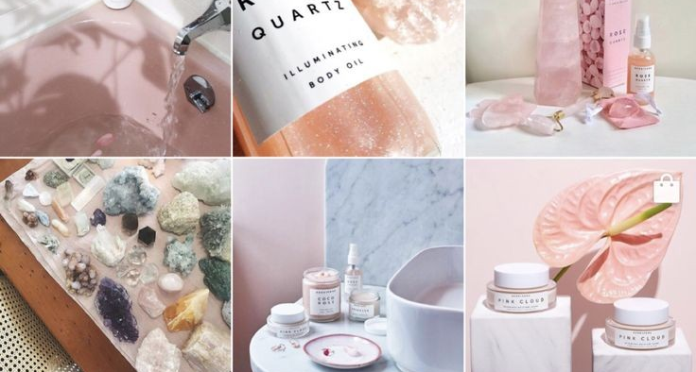
Elegant Touch

Slide 2

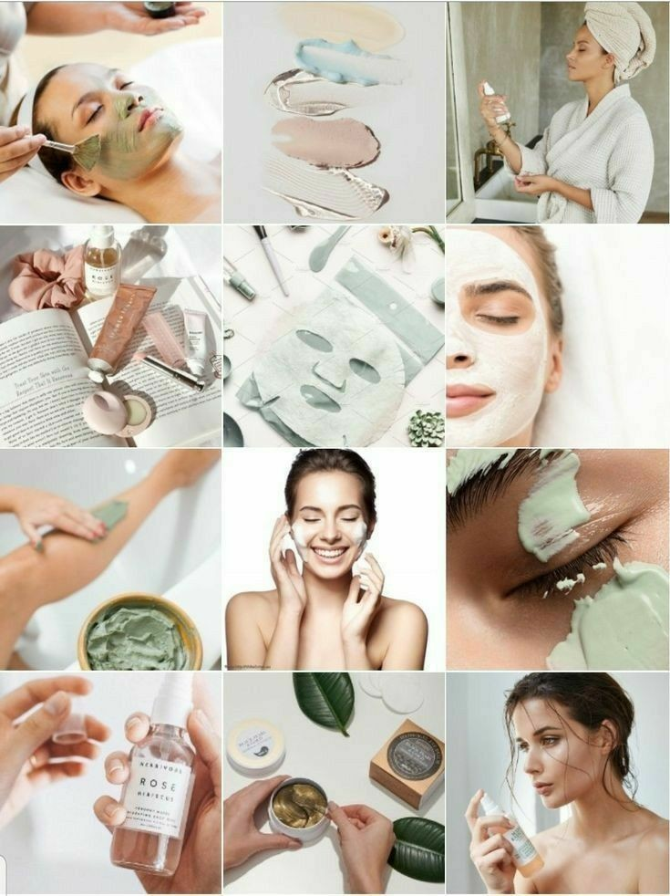
Our industry will offer ample services and facilities on skin and body care such as: a. skin/hair treatment b. mani-pedi c. spa In addition to above services, we will also launch our brand that will provide various skincare products suitable for all skin types.

Slide 3
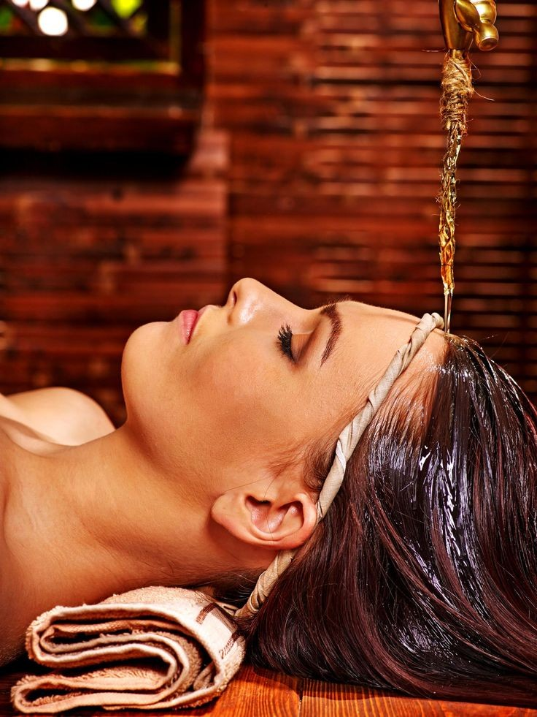
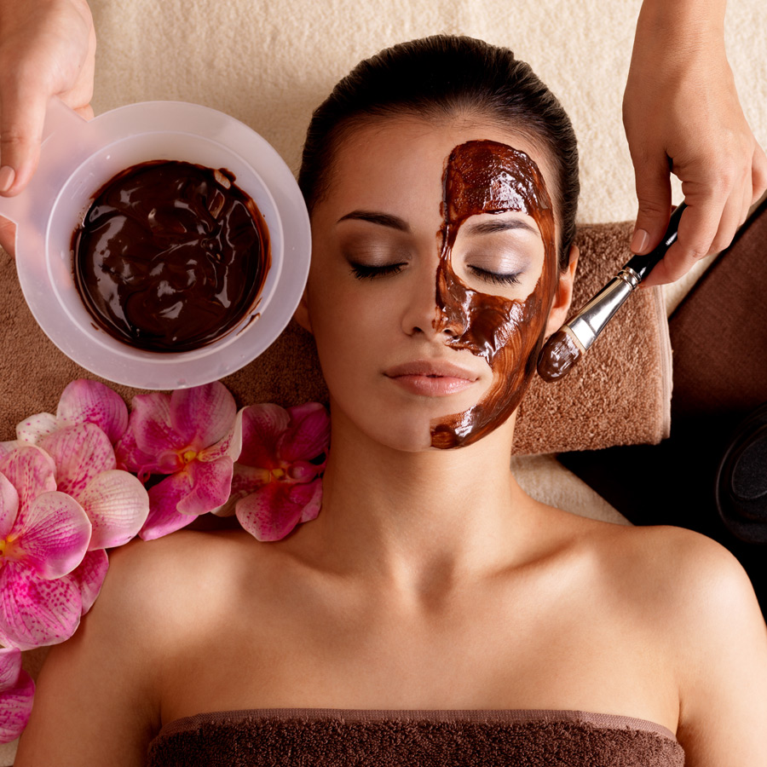
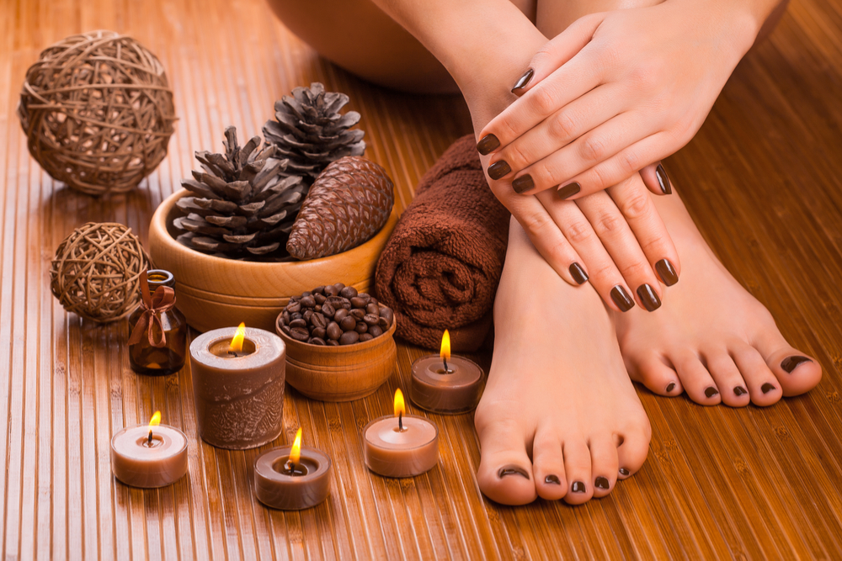
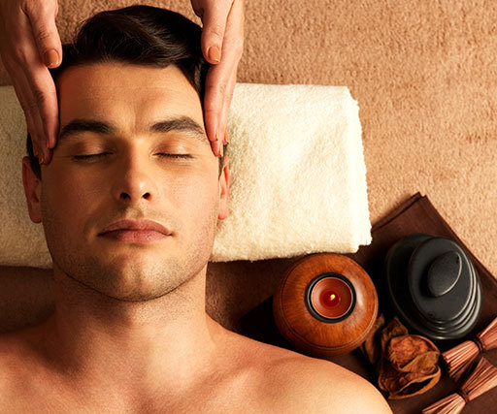
We Offer
Skin treatment
Spa
Hair treatment
Mani-pedi

Slide 4
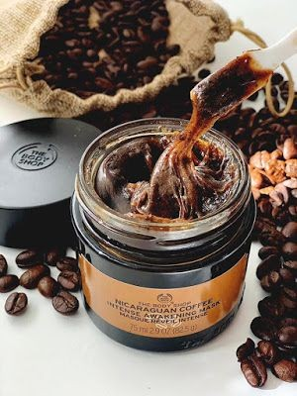
Requirements
Create skincare brand
Find a manufacturer
Manpower
Market skincare line
Build an online store

Slide 5


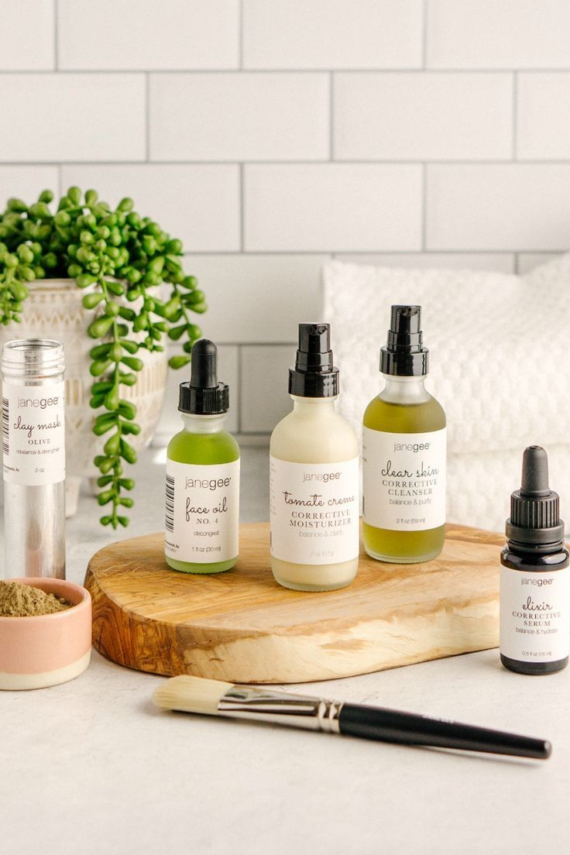
Why Us?
Because we are providing multifarious services all in one place. If any problem arises, our specialists will be there to assist our clients and equip them with all the necessities.

Slide 6
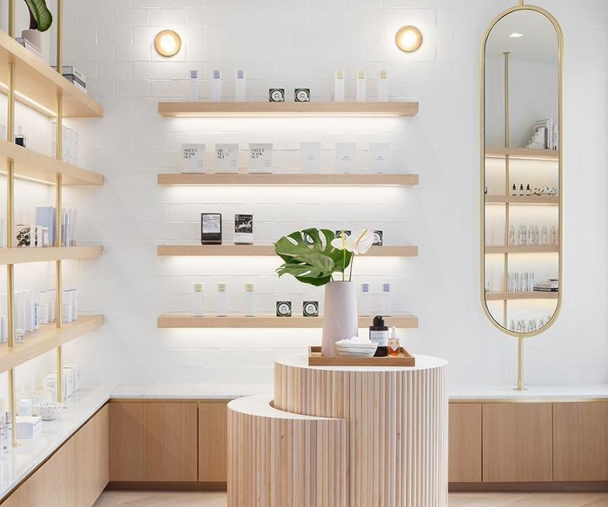
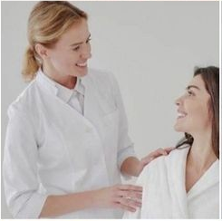
Stakeholders and Features
Admin
Login
Add products
Consultants
Login/Sign up
Notification Panel
Patient
Sign up/Login
Book Appointment
Message box
Purchase products

Slide 7
Conclusion
Good skincare is important for the following reasons:
Healthy and glowing skin
Remove dead skin cells
Prevent breakouts, wrinkles

Slide 8

THANK YOU

